Slide 1
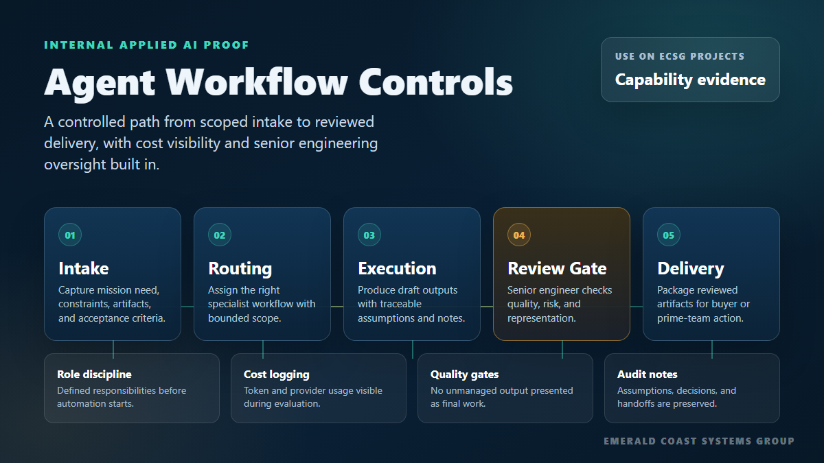
APPLIED AI CAPABILITY EVIDENCE
Agent Workflow Controls
How ECSG keeps AI-assisted work scoped, reviewed, and useful for government technical delivery.
Emerald Coast Systems Group, LLC
1

Slide 2
WHY IT MATTERS
Controls beat demos without discipline
The point is not to show a flashy bot. The point is to show that ECSG can apply automation under engineering judgment.
Bounded scope
Traceable work
Each workflow starts with mission need, constraints, artifacts, and acceptance criteria.
Assumptions, handoffs, and intermediate outputs are preserved for review.
Cost visibility
Senior review
Token usage and provider choices can be compared before scaling a workflow.
No unmanaged AI output is represented as final technical work.
Emerald Coast Systems Group, LLC
2

Slide 3
CONTROL PATH
From intake to reviewed delivery
01
02
03
04
05
Intake
Routing
Execution
Review gate
Delivery
Need, constraints, artifacts
Specialist workflow selected
Draft output with assumptions
Quality, risk, representation
Reviewed artifact package
Role discipline: defined responsibilities before automation starts.
Quality gates: review before outputs move from draft to deliverable.
Audit notes: assumptions and decisions remain visible to the team.
Emerald Coast Systems Group, LLC
3

Slide 4
DEMONSTRABLE PROOF
Working prototypes that show the pattern
These are inspection points for technical conversations, not claims of federal production deployment.
Voice intake workflow
Cost and token race
Conversational intake, live summarization, artifact handling, and triage.
Provider-neutral model comparison with cost, latency, tokens, and quality notes.
Semantic image search
SAP/RCA lab pattern
CLIP-based search pattern for retrieval and visual data triage.
A review-ready root-cause-analysis workflow used as applied-AI evidence.
Important: ECSG presents these as prototypes and capability evidence. We do not claim awarded federal past performance where it does not exist.
Emerald Coast Systems Group, LLC
4

Slide 5
HOW ECSG APPLIES IT
A practical path for buyers and prime teams
1
Discovery walkthrough
Inspect the working demos and decide whether the pattern fits a mission workflow.
2
Scoped pilot
Define data boundaries, review responsibilities, acceptance criteria, and risk controls.
3
Integration support
Connect the workflow to existing systems, tickets, repositories, documents, or dashboards.
4
Sustainment posture
Operate with documentation, runbooks, cost awareness, and accountable handoff.
Emerald Coast Systems Group, LLC
5

Slide 6
REPRESENTATION GUARDRAILS
Professional, accurate, and ready for due diligence
Brand-new small business, established June 3, 2026.
SAM/UEI/CAGE, EDWOSB/WOSB, HUBZone, GSA MAS, and 8(a) are represented only as in progress or in process until awarded.
Technical demos are prototypes running on ECSG-controlled infrastructure, not production federal systems.
AI-assisted outputs remain subject to senior engineering review.
ECSG position
Senior enterprise systems judgment, disciplined software delivery, and applied AI controls for bounded government technology problems.
info@emeraldcoastsystemsgroup.com
Emerald Coast Systems Group, LLC
6

